Slide 1
Basic Computation

Slide 2
Objectives
After studying this section, you should be able to:
Understand what is a data type
Declare constants and variables of a program
Express operations on data

Slide 3
Contents
Variables and Data types
Data Types
Integral Types
Floating-Point Types
Declarations
Basic Memory Operations
Literals
Constants
Assignment Operator
Output
Input
Expressions
Arithmetic,
Relational,
Logical
Bit Operators
Shorthand Assignment Operators
Mixing Data Types
Casting
Precedence

Slide 4
Variables and Data types

Slide 5
Introduction
Instruction: A task that hardware must perform on data.
Data can be: constants, variables.
Constants: Fixed values that can not be changed when the program executes.
Variables: Values can be changed when the program execute.
Data must be stored in the main memory (RAM).
2 basic operations on data are READ and WRITE.
Numerical data can participate in expressions.

Slide 6
Variables
A variable is a name referencing to a memory location (address)
Holds binary data
Two basic operations: set value, get value.
When the program is compiled, the compiler will determine the position where the variable is allocated.
Questions:
Where is it? → It’s Address
How many bytes does it occupy? → Data type
0000 1001
1100 0011
c
b
a
Memory

Slide 7
Data Types
The C language associates a data type with each variable. Each data type occupies a compiler-defined number of bytes.
A data type defines:
How the values are stored and
How the operations on those values are performed.
Typed languages defined some primitive data types.

Slide 8
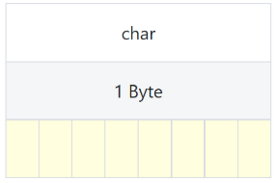
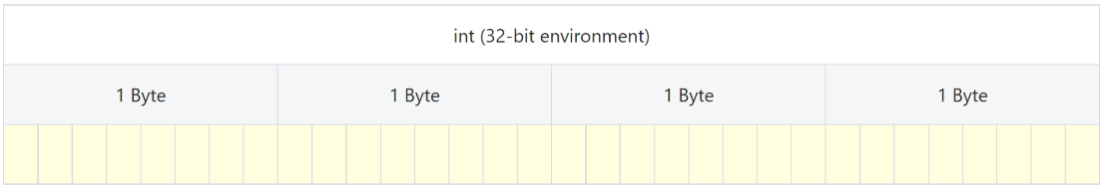
Arithmetic Types
The four most common types of the C language for performing arithmetic calculations are: char, int, float, double
char: Occupies one byte and can store a small integer value, a single character or a single symbol:
int: occupies one word and can store an integer value. In a 32-bit environment, an int occupies 4 bytes:

Slide 9
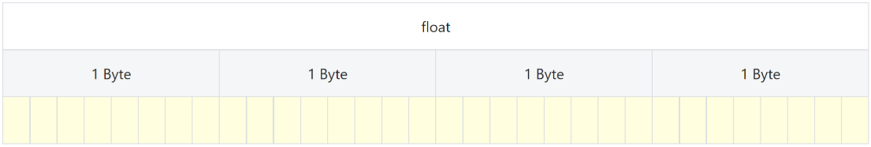
Arithmetic Types (cont.)
float: typically occupies 4 bytes and can store a single-precision, floating-point number:
double: typically occupies 8 bytes and can store a double-precision, floating-point number:

Slide 10
int Type Size Specifiers
Specifying the size of an int ensures that the type contains a minimum number of bits. The three specifiers are:
short: at least 16 bits
long: at least 32 bits
long long: at least 64 bits
Standard C does not specify that a long double must occupy a minimum number of bits, only that it occupies no fewer bits than a double.

Slide 11
double Type Size Specifier
The size of a long double depends on the environment and is typically at least 64 bits:
long double type only ensures that it contains at least as many bits as a double

Slide 12
const Qualifier
Any type can hold a constant value.
A constant value cannot be changed.
To qualify a type as holding a constant value we use the keyword const
A type qualified as const is unmodifiable.
If a program instruction attempts to modify a const qualified type, the compiler will report an error.

Slide 13
Representing Values
Hardware manufacturers distinguish integral types from floating-point types and represent integral data and floating-point data differently.
Integral types: char, int
Floating-point types: float, double

Slide 14
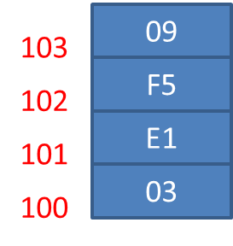
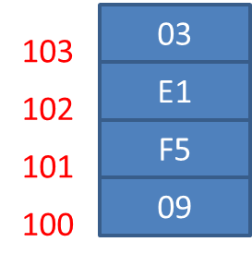
Representation of Integral Values
C stores integral values in equivalent binary form.
Non-Negative Values:
Intel uses this little-endian ordering.
Motorola uses big-endian ordering.
Each CPU family has it’s own way to store data . So, compilers must have a suitable way for copying data from this variable to other. And due to this reason also, each compiler can run well only on a specific family of CPU only. A supplier may supply some versions of their compiler for some CPU families.
Value is stored:
09F5E103
Least significant is stored in lowest byte
Most significant is stored in lowest byte

Slide 15
Exercise 1:
Convert the following decimal integers to binary:
63 _________________________________________________
219 ________________________________________________
Convert the following binary notation to decimal:
0111 0101 ___________________________________________
0011 1011 ___________________________________________
0011 1111
1101 1011
117
59

Slide 16
Negative and Positive Values
Computers store negative integers using encoding schemes:
Two's complement notation,
One's complement notation, and
Sign magnitude notation.
All of these schemes represent non-negative integers identically.
The most popular scheme is two's complement.
To obtain the two's complement of an integer, we:
Flip the bits (1-complement)
Add one → 2-complement

Slide 17
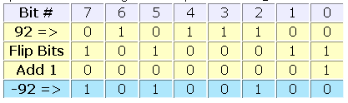
Two's complement notation
To obtain the two's complement of an integer, we
Flip the bits
Add one
For example, we represent the integer -92 by 10100100₂

Slide 18
Exercise 2: Use signed 1-byte integral number
What is the two's complement notation of
-63_______________________________________________
-219______________________________________________
Convert the following binary notation to decimal:
1111 0101_________________________________________
1011 1011_________________________________________
1100 0001
0010 0101
-11
-69

Slide 19
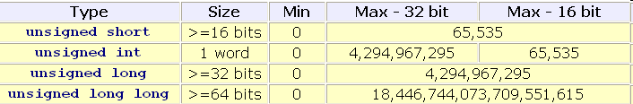
Unsigned Integers
We can use all of the bits available to store the value of a variable.
With unsigned variables, there is no need for a negative-value encoding scheme.

Slide 20
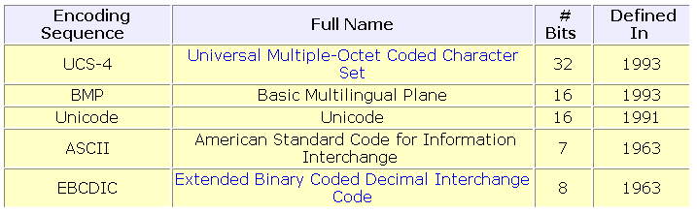
Cultural Symbols (characters)
We store cultural symbols using an integral data type.
We store a symbol by storing the integer associated with the symbol.
Over 60 encoding sequences have already been defined.
We use the ASCII encoding sequence throughout this course

Slide 21
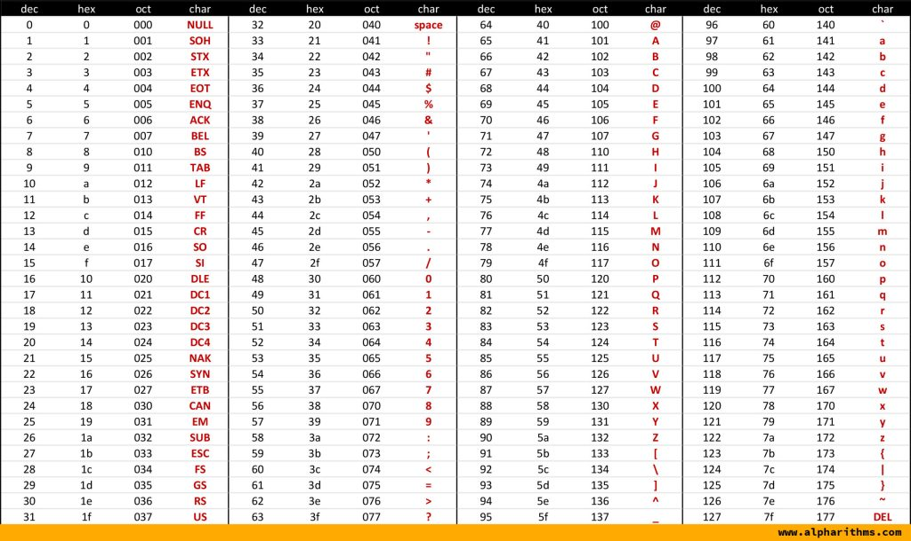
ASCII table for characters

Slide 22
Exercise 3:
You are tasked to write a program to manage a small library system. Choose the most suitable data type for each variable based on the information provided.
The library needs to store the following information:
Total number of books in the library (e.g., 10,000).
Average price of books in dollars (e.g., 15.75).
A single character indicates the book's genre ('F' for Fiction, 'N' for Non-fiction, etc.).
The unique ID of a book (e.g., 2345678901).
Whether a book is available or not (1 for available, 0 for not available).
Number of pages in a book (e.g., 500).
Tasks:
Choose an appropriate data type for each variable and explain your choice.
Declare variables using the chosen data types and initialize them with sample values.
Print all the values along with their data types.

Slide 23
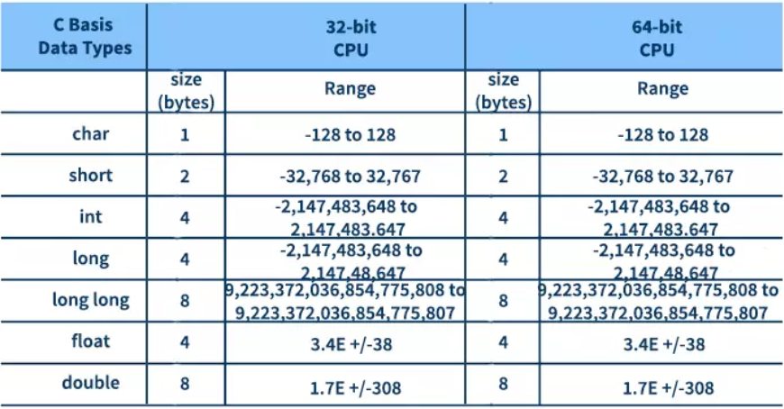
The range of values of data types

Slide 24
Declaring (Creating) Variables
To create a variable, specify the data type and assign it a value:
Syntax:
For example:
char section
int numberOfClasses;
double cashFare = 2.25;
Rules for naming variables are:
Names can contain letters, digits and underscores.
Names must begin with a letter or an underscore (_)
Names are case-sensitive (myVar and myvar are different variables)
Names cannot contain whitespaces or special characters like !, #, %, etc.
Must not be a C reserved word
data_type identifier [= initial value];

Slide 25
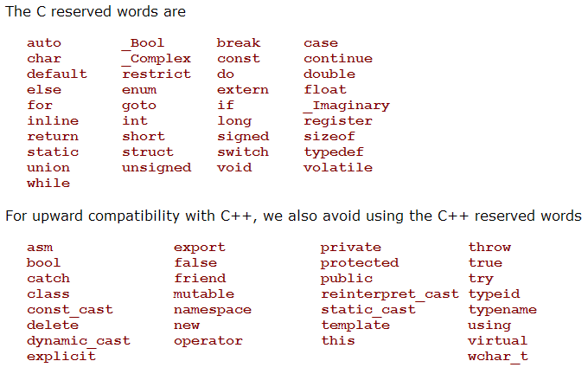
Reserved words

Slide 26
Exercise 4:
You are tasked to create a C program that calculates the area and perimeter of a rectangle. As part of this exercise, ensure that all variable names:
Follow the rules for valid naming in C.
Are descriptive and meaningful to improve readability.
Follow common naming conventions (e.g., camelCase or snake_case).
Tasks:
Identify the rules for valid variable names in C and apply them.
Choose appropriate and meaningful variable names for the program.
Write the program using the chosen names.
Notes:
Rules for Valid Variable Names in C
Variable names must begin with a letter (A-Z, a-z) or an underscore (_).
After the first character, the name can include letters, digits (0-9), or underscores (_).
Variable names are case-sensitive.
Reserved keywords (like int, float, return, etc.) cannot be used as variable names.
Avoid names that start with an underscore followed by a capital letter or are entirely in uppercase, as they are often reserved for system use.
Solution: C Program
#include <stdio.h>
int main() {
// Declare variables with valid and meaningful names
float length; // Length of the rectangle
float width; // Width of the rectangle
float area; // Area of the rectangle
float perimeter; // Perimeter of the rectangle
// Prompt user for input
printf("Enter the length of the rectangle: ");
scanf("%f", &length);
printf("Enter the width of the rectangle: ");
scanf("%f", &width);
// Calculate area and perimeter
area = length * width;
perimeter = 2 * (length + width);
// Display the results
printf("The area of the rectangle is: %.2f\n", area);
printf("The perimeter of the rectangle is: %.2f\n", perimeter);
return 0;
}

Slide 27
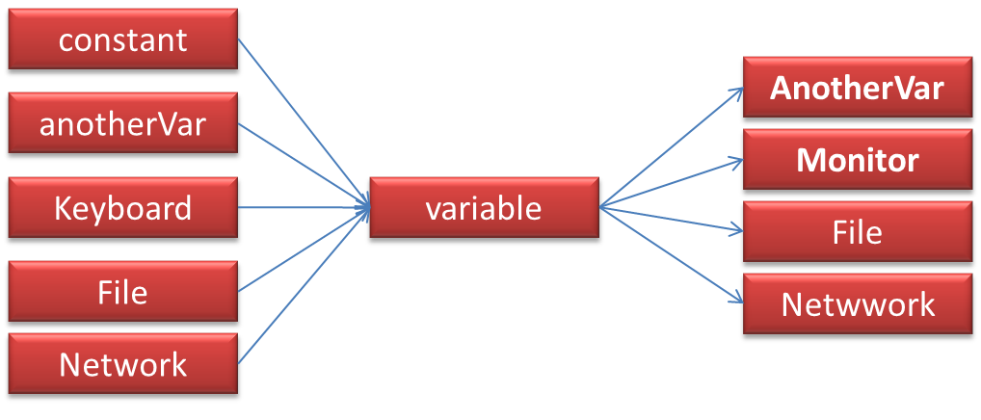
Some operations on variables:
Assign a constant value to a variable,
Assign the value of another variable to a variable,
Output the value of a variable,
Input a fresh value into a variable's memory location.

Slide 28
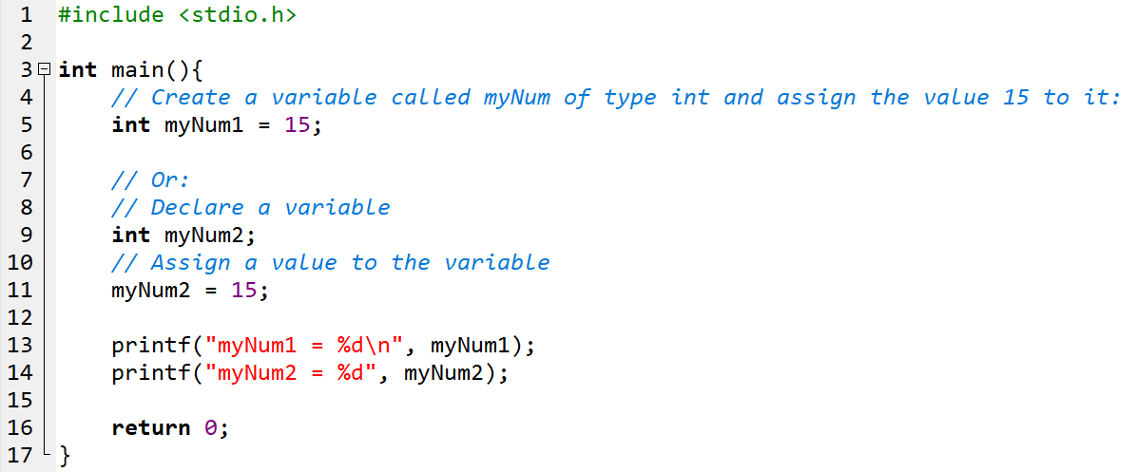
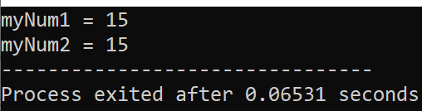
Example 1: Variable & Data Types
Output:

Slide 29
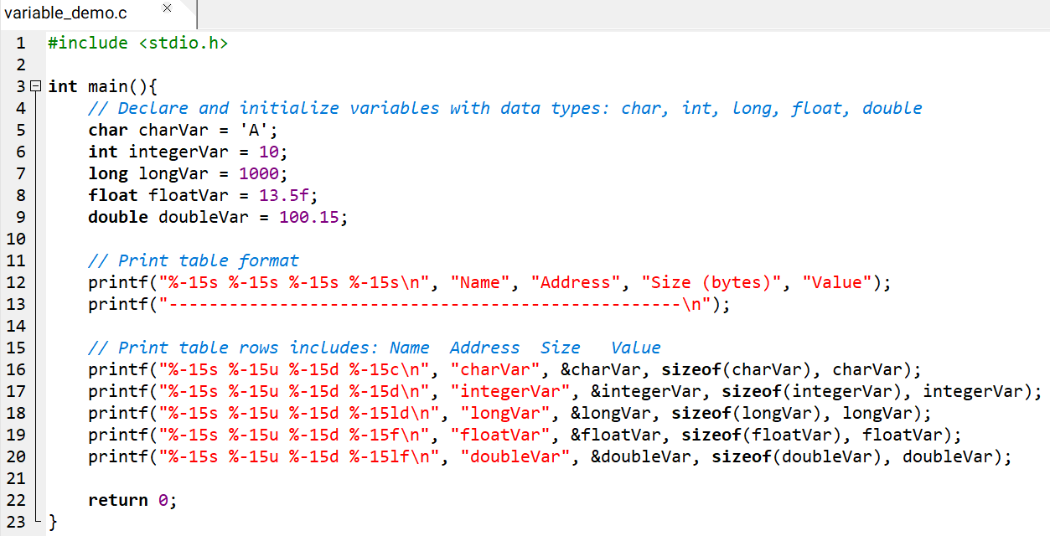
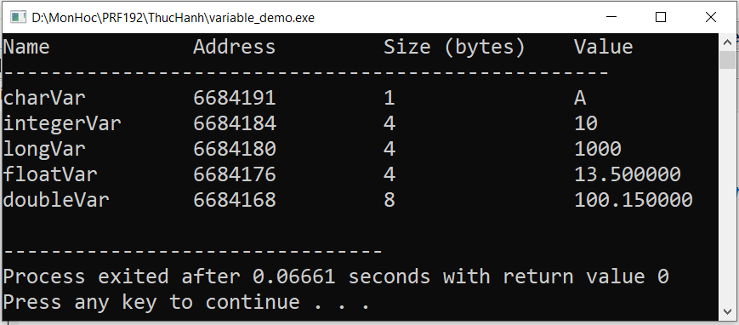
Example 2: Variable & Data Types
Conversion Specifiers
& String format
Where are variables stored and how many bytes do they occupy?
The operator & will get the address of a variable or code.
The operator sizeof(var/type) return the size (number of byte) occupied by a variable/type

Slide 30
Questions as Summary
What is a variable?
What is a data type?
Characteristics of a data type are …… and …
The size of the int data type is …. Bytes.
Choose the wrong declarations:
int n = 10;
char c1, c2 = ‘A’;
int m = 19; k = 2;
char c3; int t;
Float f1; f2 = 5.1;
Explain little-endian ordering and big-endian ordering.

Slide 31
Basic Memory Operations

Slide 32
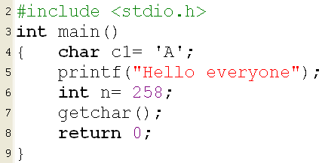
1. Literals
Constant values are specified directly in the source code.
They can be
Character literals (constant characters)
String literals(constant strings)
Number literals (constant numbers)

Slide 33
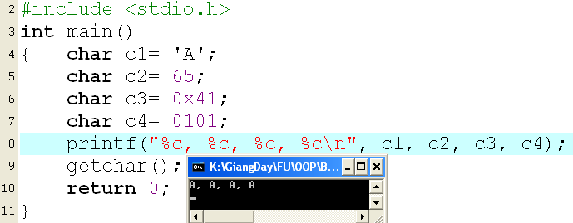
Literals: Characters, Strings
4 ways for representing a character literal:
Enclose the character single quotes ‘A’
Decimal ASCII code of the character 65 for ‘A’
Octal ASCII code of the character 0101 for ‘A’,
Hexadecimal ASCII code of the character 0x41 for ‘A’,
Assign value to a variable:
The operator =

Slide 34
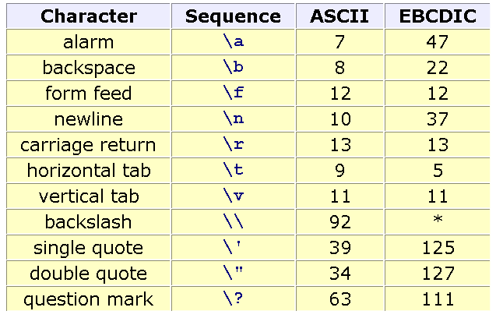
Literals: Escape Sequences
Pre-defined literals for special actions:

Slide 35
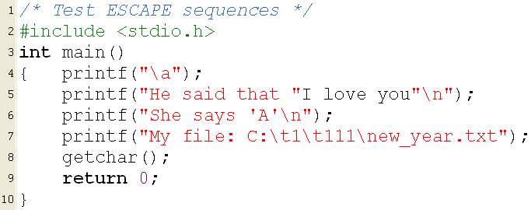
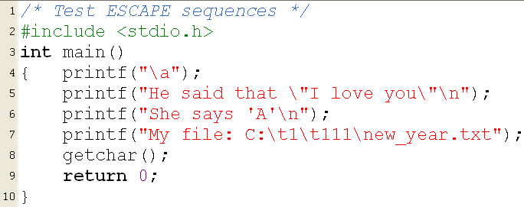
Literals: Escape Sequences (cont.)
Error! Why?
Modify then run it
Change \ to \\ then run it

Slide 36
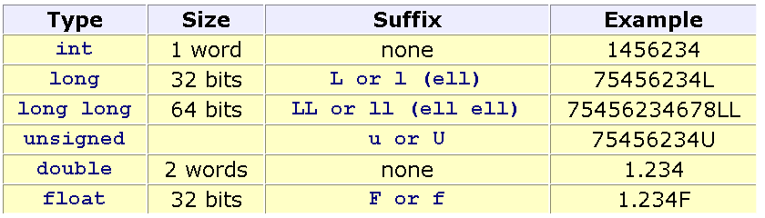
Literals: Numbers
The compiler will convert directly numeric literals (constants) to binary numbers and put them in the executable file. → How long of binary constants? → They depend on their data types specified by programmers.
Default: Integral value → int, real number → double
Specifying data type of constants: Suffixes after numbers.

Slide 37
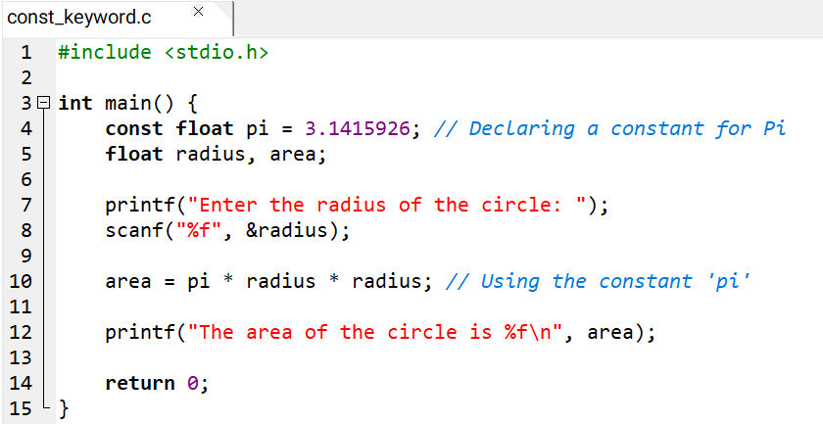
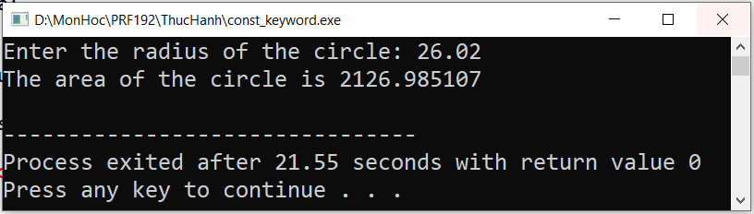
2. Named Constants
Use const keyword
Syntax:
For example:
const data_type constant_name = value;
Output:

Slide 38
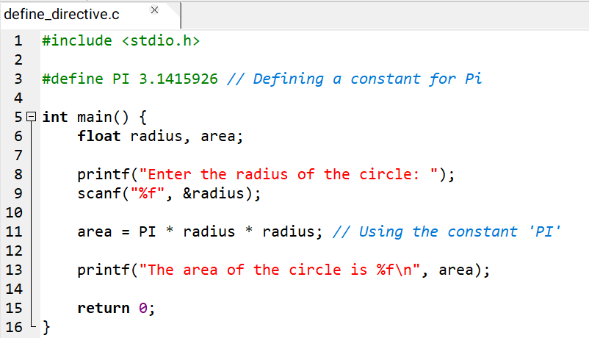
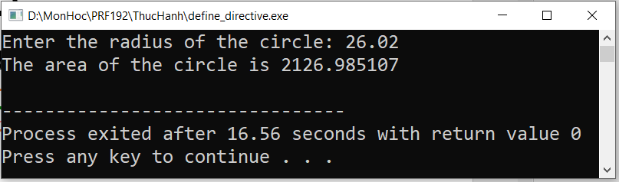
2. Named Constants (cont.)
Use the pre-processor (pre-compiled directive) #define
Syntax:
For example:
#define constant_name value
Output:

Slide 39

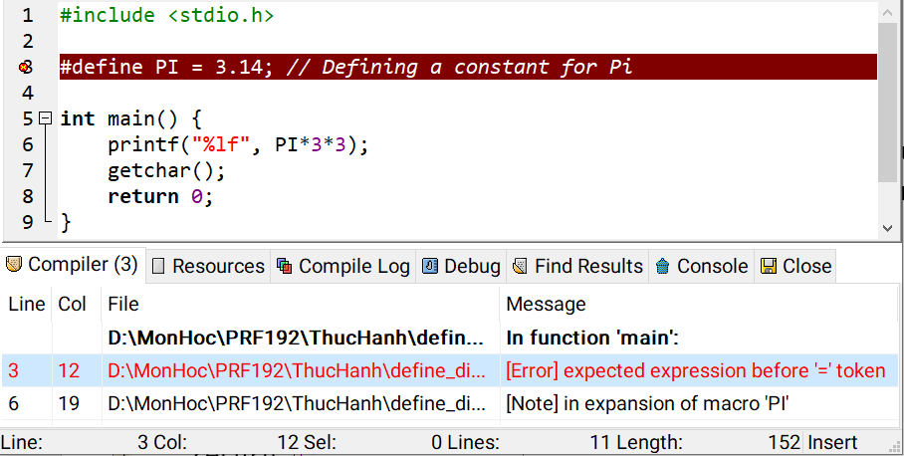
2. Named Constants (cont.)
Attention when the directive #define is used:
The compiler will not allocate memory block for values but all pre-defined names in the source code will be replaced by their values before the translation performs (The MACRO REPLACEMENT)
A name is call as a MACRO.
replace

Slide 40
3. Input/ Output variables
Monitor is
a character
device
3
3
Binary code of 3 for calculating
Convert
00110011
ASCII code of the digit
3
00110011
00000011
convert
00110011
Keyboard is
a character
device
3
3
Conversion rules are pre-defined in C

Slide 41
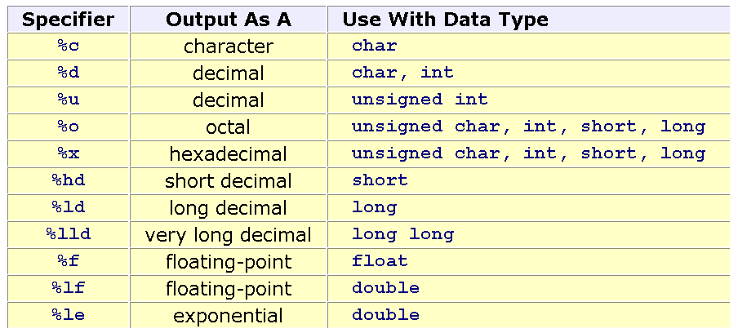
Conversion Specifiers

Slide 42
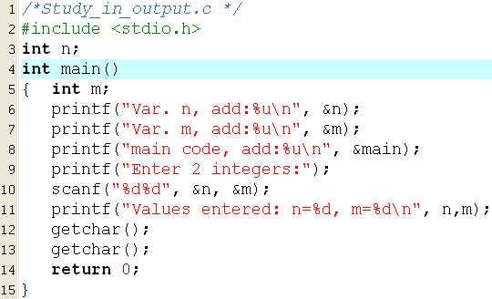
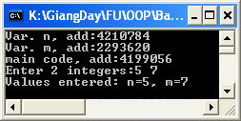
Example 1:
4210784
n
main
4199056
2293620
m
Format string
scanf( “%d%d”, &n, &m) →
scanf( “%d%d”, 4210784, 2293620) means that get keys pressed then change them to decimal integers and store them to memory locations 4210784, 2293620.

Slide 43
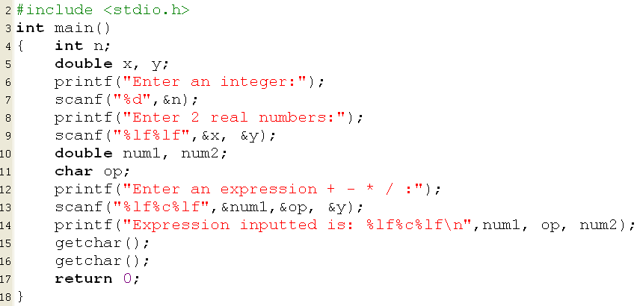


Example 2:
Input a value to a variable:
scanf (“input format”, &var1, &var2,…)
Output the value of a variable:
printf (“output format”, var1, var2,…)
The function scanf receive the BLANK or ENTER KEYS as separators.
Format string
Data holders

Slide 44
Question
Explain means of parameters of the scanf(…) and the printf(…) functions.
Use words “left” and “right”. The assignment x=y; will copy the value in the ….. side to the ….. side.

Slide 45
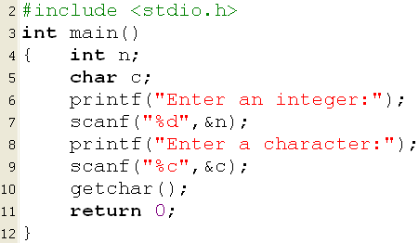
Exercise 5:
Develop a C program in which 2 integers, 2 float numbers and 2 double numbers are declared. Ask user for values of them then print out values and addresses of them. Write down the memory map of the program.
Run the following program:
Why user do not have a chance to stroke the ENTER key before the program terminate?
Modify and re-run:
getchar();

Slide 46
Expressions

Slide 47
Expressions
Expression is a valid association of constants, variables, operators and functions and returns an only result.
Examples:
32-x+y/6 16.5 + 4/sqrt(15) * 17 – 8
45 > 5*x y = 17 + 6*5/9 –z*z
Hardware for calculating expressions: ALU
Operations that can be supported by ALU: Arithmetic, relational and logic operations.

Slide 48
1. Arithmetic Operators
Op. | Syntax | Description | Example
+ | +x | leaves the variable, constant or expression unchanged | y = +x ; ←→ y = x;
- | -x | reverses the sign of the variable | y= -x;
+ - | x+y x-y | Add/substract values of two operands | z= x+y; t = x-y;
* / | x*y x/y | Multiplies values of two operands Get the quotient of a division | z= x-y; z = 10/3; → 3 z = 10.0/3; → 3.3333333
% | x%y | Get remainder of a integral division | 17%3 → 2 15.0 % 3 → ERROR
++ -- | ++x --x x++ x-- | Increase/decrease the value of a variable (prefix/postfix operators) | Demo in the next slide.

Slide 49
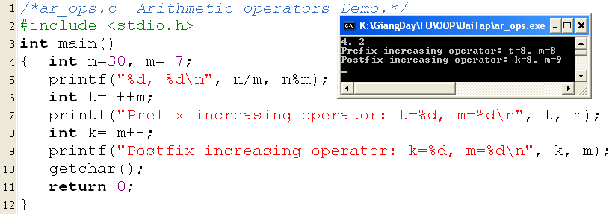
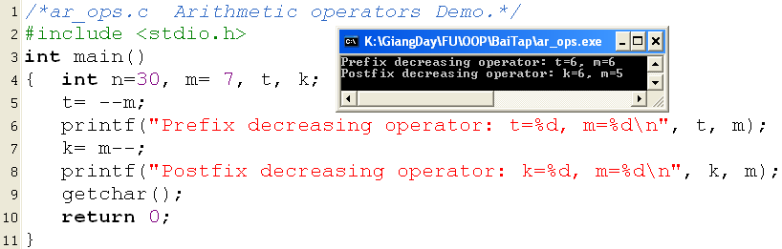
1. Arithmetic Operators - Example 1

Slide 50
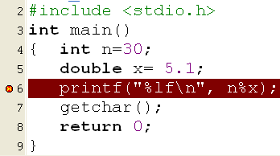

1. Arithmetic Operators - Example 2
?
Explain yourself the output
Statistic:
Multiply > Division
Integral operations > floating-point ones.

Slide 51
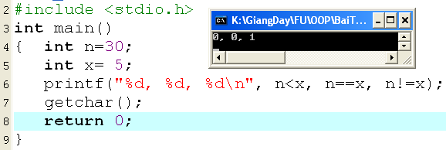
2. Relational Operators
For comparisional operators.
< <= == >= > !=
Return 1: true/ 0: false

Slide 52
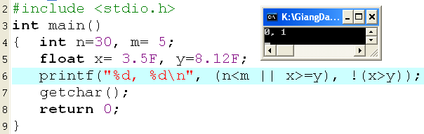
3. Logical Operators
Operator for association of conditions
&& (and), || (or) , ! (not)
Return 1: true, 0: false

Slide 53
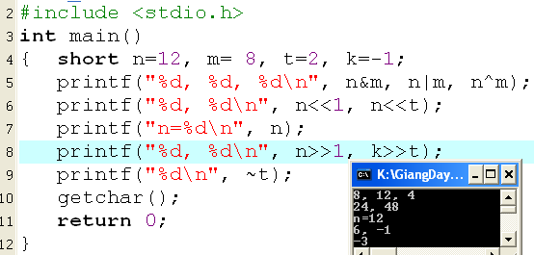
4. Bitwise Operators
& (and), | (or) , ^ (xor): Will act on a pair of bits at the same position in 2 operands.
<< Left shift bits of the operand (operands unchanged)
>> Right shift bits of the operand (operands unchanged, the sign is preserved.)
~ : Inverse bits of the operand.
n&m
0000 0000 0000 1100
0000 0000 0000 1000
0000 0000 0000 1000 → 8
n=12: 0000 0000 0000 1100
m= 8: 0000 0000 0000 1000
n|m
0000 0000 0000 1100
0000 0000 0000 1000
0000 0000 0000 1100 → 12
n^m
0000 0000 0000 1100
0000 0000 0000 1000
0000 0000 0000 0100 → 4

Slide 54
4. Bitwise Operators (cont.)
n=12: 0000 0000 0000 1100
n<<1:
0000 0000 0000 1100
0000 0000 0001 100 ← 0
0000 0000 0001 1000 (24₁₀)
Left shift 1 bit: multiply by 2
n=12: 0000 0000 0000 1100
n>>1:
Sign: 0
0000 0000 0000 1100
0000 0000 0000 110
Add the sign to the left”
0000 0000 0000 110 ➔ 6
k=-1:
1: 0000 0000 0000 0001
-1: 1111 1111 1111 1111 (2-complement)
Sign: 1
1111 1111 1111
111 1111 1 111 1111
Add the sign to the left:
1111 1111 1111 1111 → (-1₁₀)

Slide 55
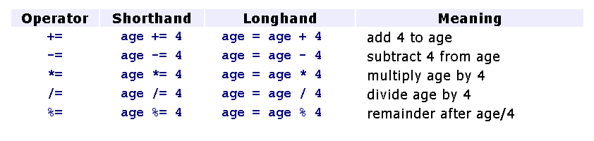
5. Assignments Operators
Variable = expression
Shorthand assignments:

Slide 56
6. Mixing Data Types
Although the ALU does not perform operations on operands of differing data type directly, C compilers can interpret expressions that contain operands of differing data type.
If a binary expression contains operands of differing type, a C compiler changes the data type of one of the operands to match the other.
Data type hierarchy: double, float, long, int , char .

Slide 57
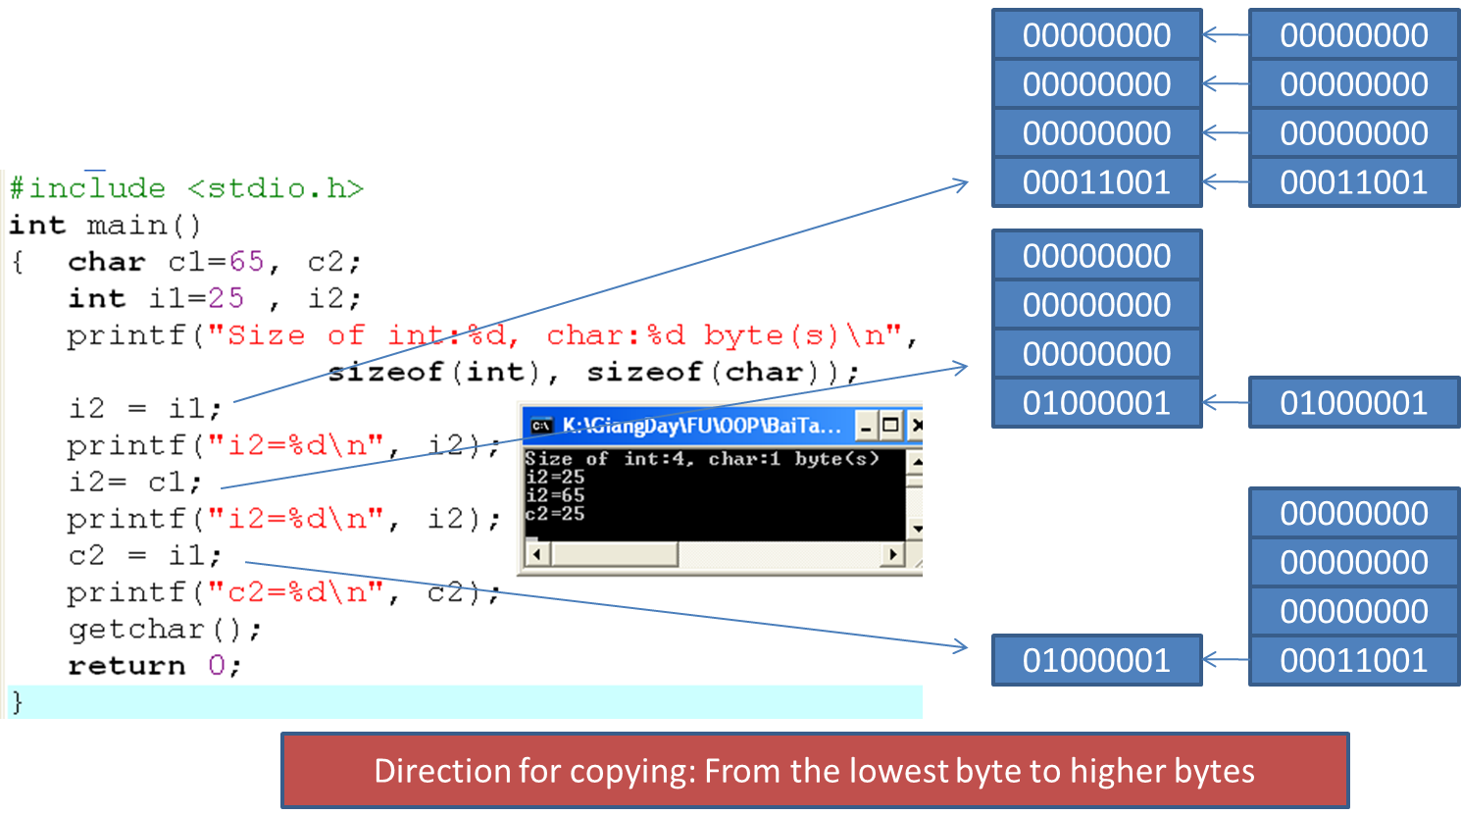
6. Mixing Data Types (cont.)
Casting Data Type: x = y;

Slide 58
6. Mixing Data Types (cont.)
Implicit Casting for the assignment
If the data type of the variable on the left side of an assignment operator differs from the data type of the right side operand, the compiler:
Promotes the right operand to the data type of the left operand if the left operand is of a higher data type than the right operand,
Truncates the right operand to the data type of the left operand if the left operand is of a lower data type than the right operand.
0000 0000
0000 0000
0000 0000
0100 0001
0100 0001
0000 0000
0000 0000
0000 0000
0001 1001
0001 1001

Slide 59
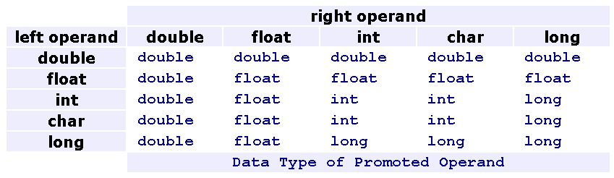
6. Mixing Data Types (cont.)
Implicit Casting for arithmetic and relational expressions
If the operands in an arithmetic or relational expression differ in data type, the compiler promotes the value of lower data type to a value of higher data type before implementing the operation.
int n=3; long t=123; double x=5.3;
3*n + 620*t – 3*x
(int*int) + (int*long) - (int*double)
int + long - double
long - double
double

Slide 60
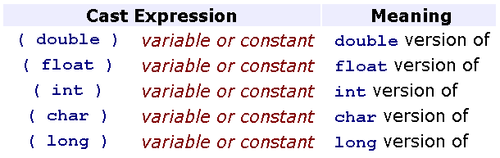
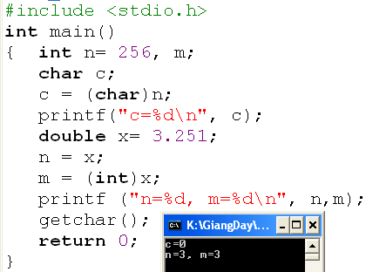
6. Mixing Data Types (cont.)
Explicit Casting
We may temporarily change the data type of any operand in any expression to obtain a result of a certain data type.
00000000
00000000
00000001
00000000
00000000
c
n

Slide 61
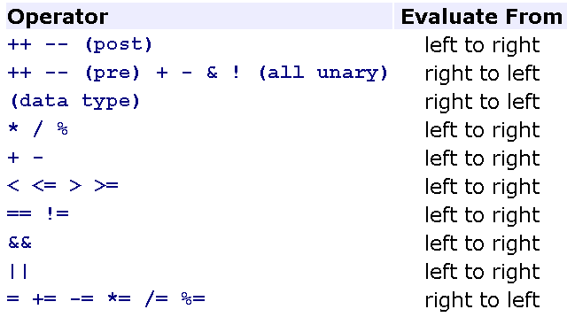
7. Operator Precedence
In a expression containing some more than one operator. Which operator will perform first? → Pre-defined Precedence.
We can use ( ) to instruct the compiler to evaluate the expression within the parentheses first
int m=3, k=2, n=4;
What is the results?
m<n
k<m<n
k>m>n
m<n>k
m&& k<n

Slide 62
Summary
Variable is ……
Basic memory operations are…..
Expression is ……….
Which of the following operators will change value of a variable? + - * / % ++
Which of the following operators can accept only one operand? + - * / % --
13 & 7 = ?
62 | 53 = ?
17 ^ 21 = ?
12 >> 2 = ?
65 << 3 = ?

Slide 63
Summary (cont.)
Expressions
Arithmetic operators
Relational operators
Logical operators
Bit operators
Shorthand Assignment Operators
Casting
Precedence

